Slide 1
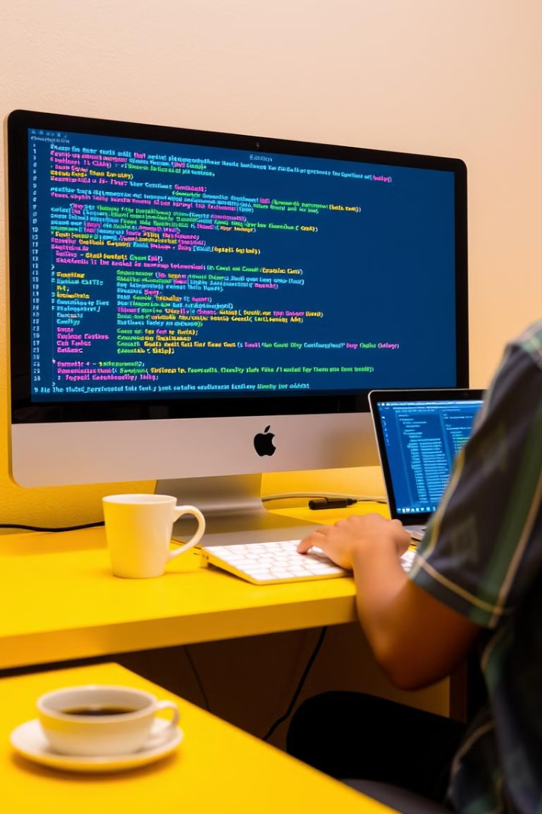

PRADUMN ATUL GHADGE
D-53
D2 BATCH
WEB DEVELOPMENT
MENTOR- MANISHA KHADSE MA’AM

Slide 2
Web Developer Role and Responsibilities
Building and Maintaining Websites
Troubleshooting and Debugging
Collaborating with Teams
Working with designers, project managers, and clients
Design, development, and deployment
Fixing errors and ensuring smooth functionality

Slide 3

Front-end, Back-end, and Full-stack Development
Front-end
Back-end
User interface (UI) and user experience (UX)
Server-side logic, databases, and security
Full-stack
Expertise in both front-end and back-end development

Slide 4
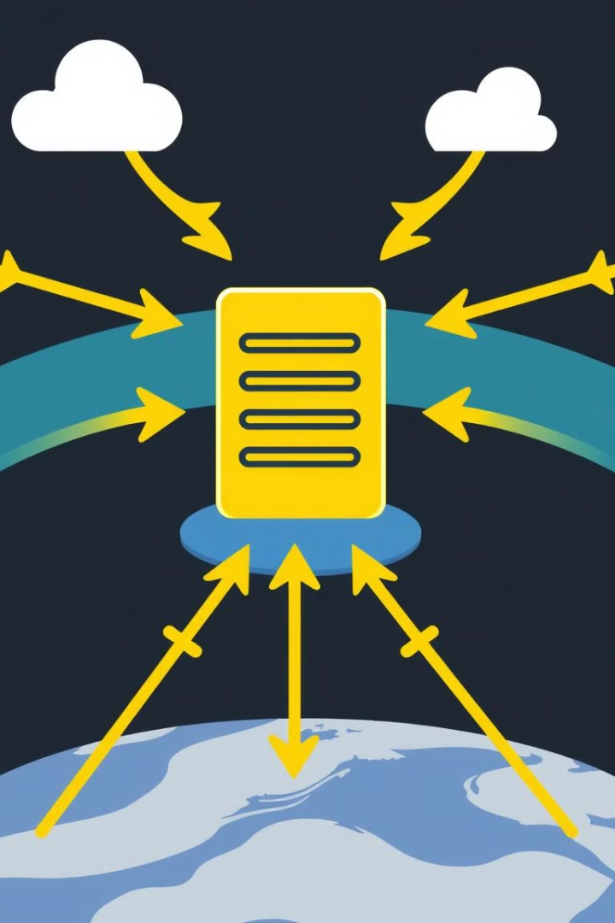



How the Internet Works: Web Servers and Clients
Request
User's browser sends a request for a web page
Response
Web server processes the request and sends back the page
Display
Browser interprets the response and displays the web page

Slide 5

Website and Web Page Fundamentals
1
Website
2
Web Page
Collection of web pages
Single document on the internet
3
Domain Name
4
URL
Human-readable address of a website
Unique address of a web page

Slide 6

Web Browsers and How They Work
Request
Retrieval
User types a URL into the browser
Browser downloads the web page's HTML code
1
2
3
4
Connection
Rendering
Browser connects to the web server
Browser renders the HTML, CSS, and JavaScript

Slide 7



Web Hosting Basics
Hosting Provider
1
Stores your website files
Server
2
Physical computer hosting your website
Domain Name
3
Website address

Slide 8





Internet Protocols: HTTP, HTML, CSS, JavaScript
HTTP
HTML
CSS
JavaScript
Protocol for transferring data over the internet
Structure and content of web pages
Styling and presentation of web pages
Interactivity and dynamic behavior

Slide 9
APIs and Web Services
API (Application Programming Interface)
1
Set of rules for software interaction
Web Services
2
Software components that communicate over the internet
Data Exchange
3
APIs enable data exchange between different applications

Slide 10
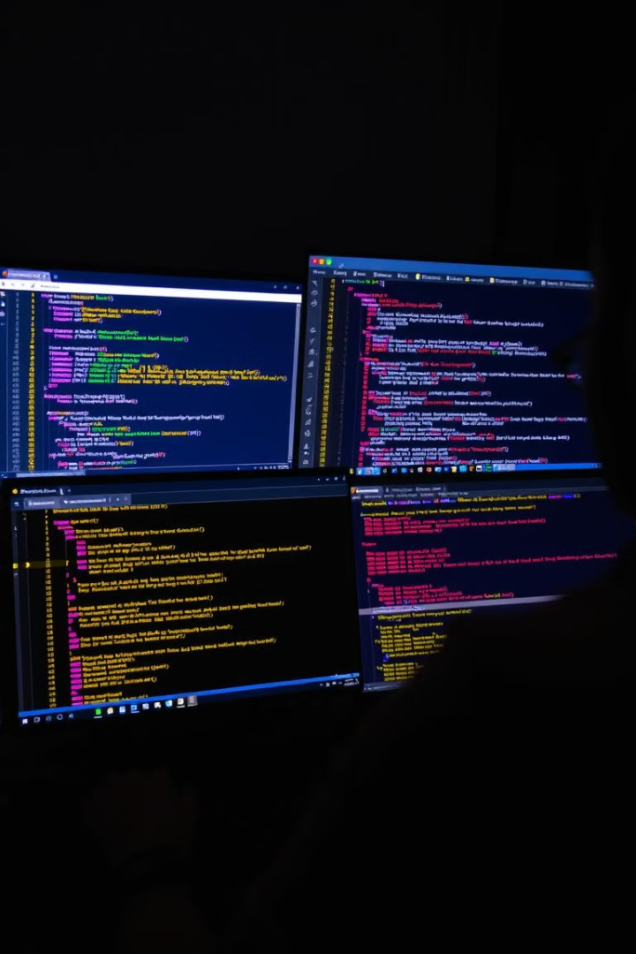
Integrated Development Environments (IDEs)
1
2
Code Editor
Debugger
Writing and editing code
Finding and fixing errors in code
3
4
Build Tools
Version Control
Automating the build process
Tracking changes to code

Slide 11
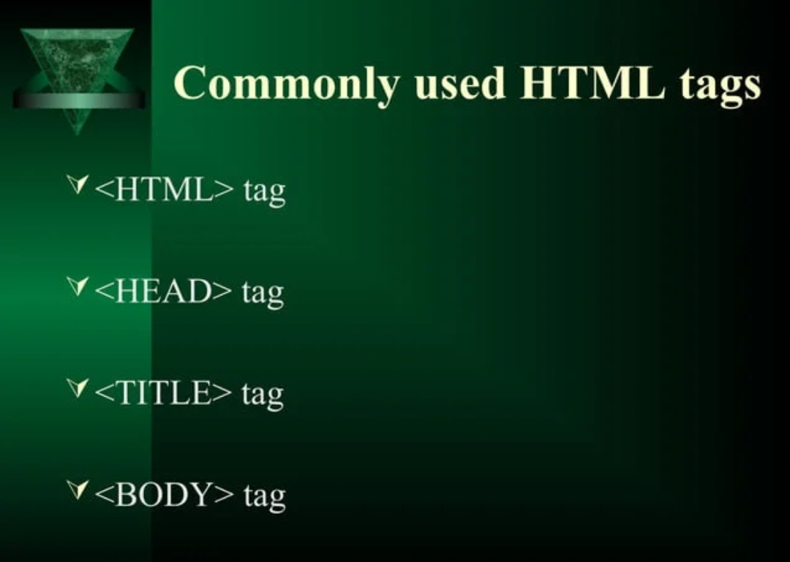

Slide 12
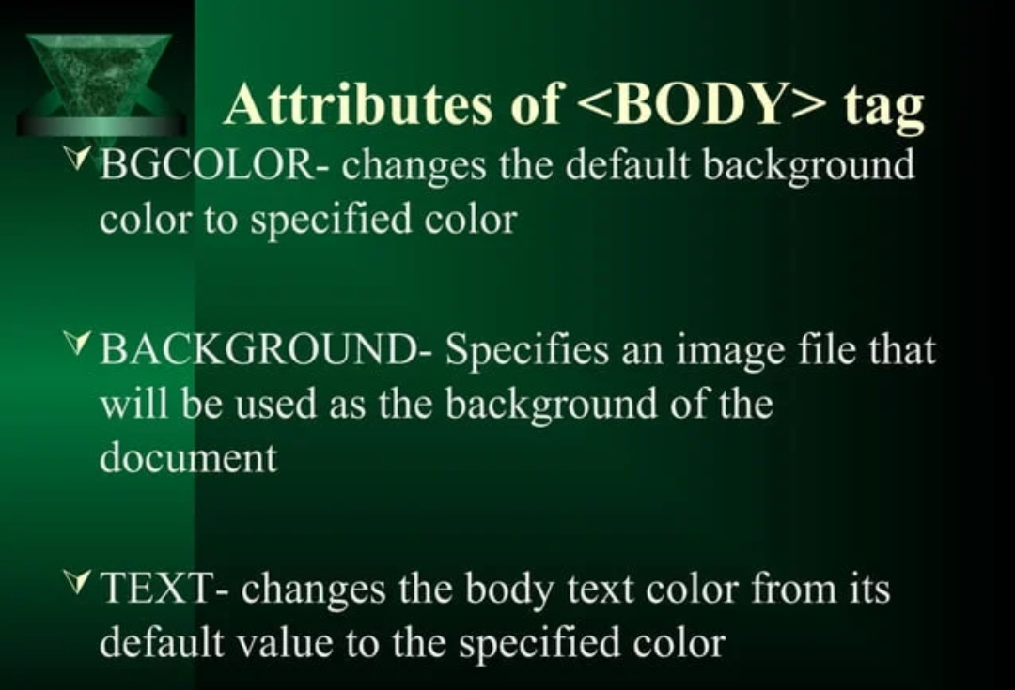

Slide 13
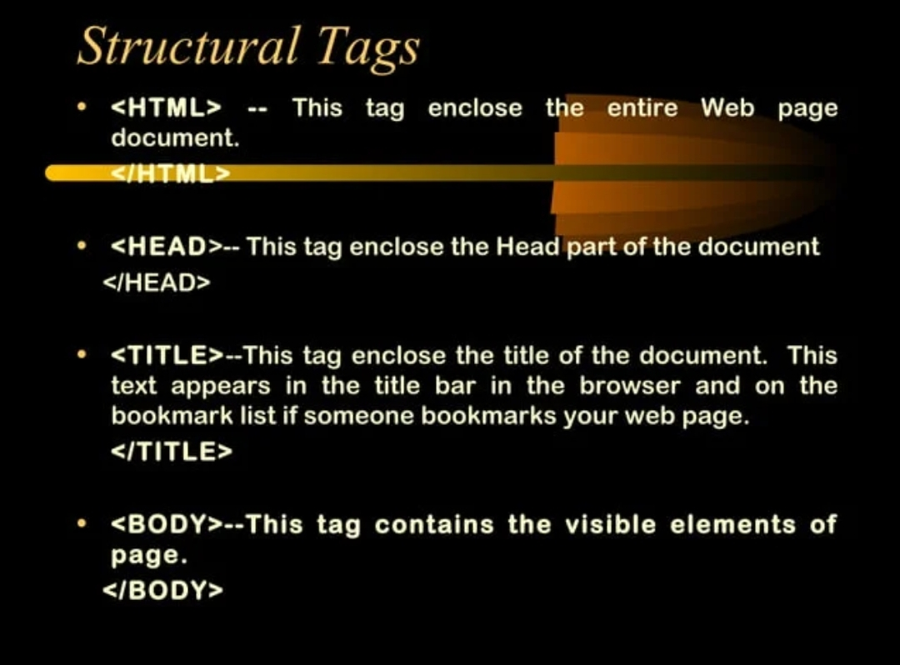

Slide 14
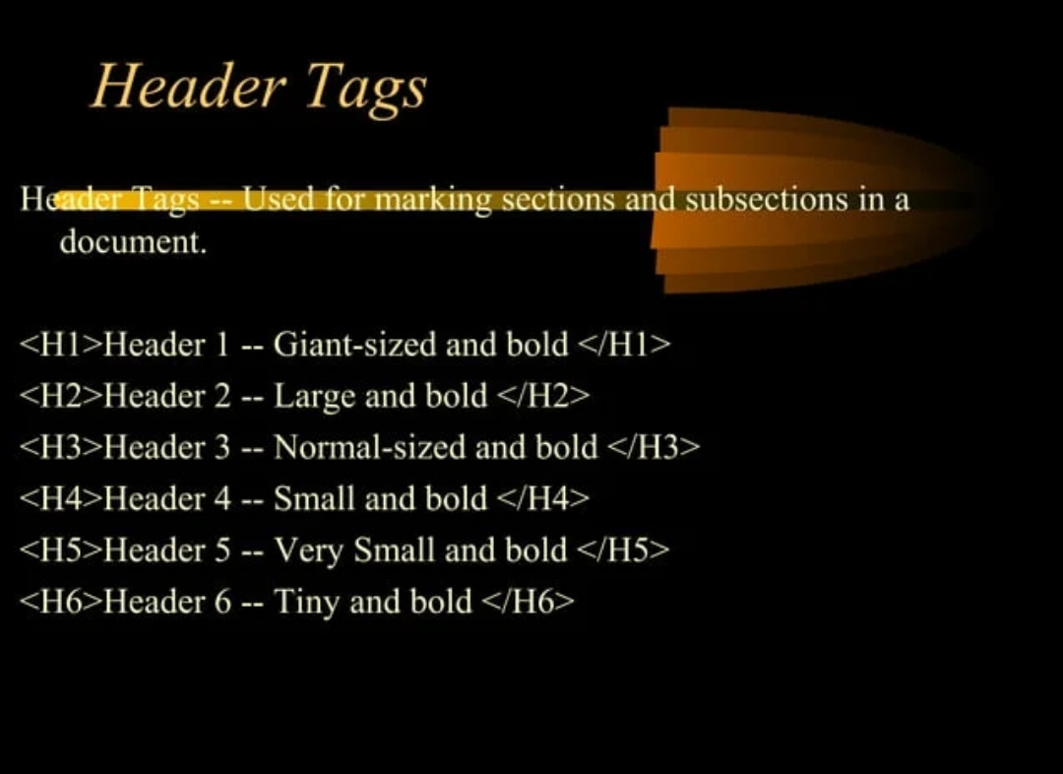

Slide 15
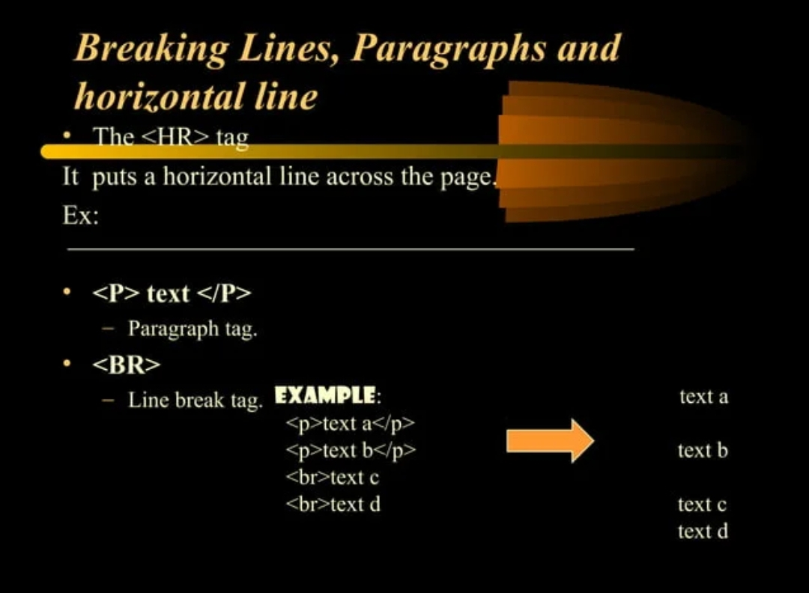

Slide 16
